Slide 1
IoT - End to End Requirements Industrial IoT (IIoT) perspective
Internet of Things
Module lead: Dr Mir Seyedebrahimi

Slide 2
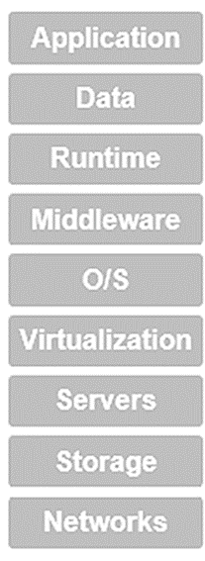
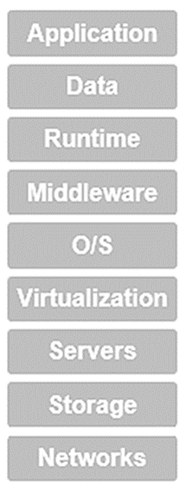
IoT reference model breakdown
Portals/Dashboards/APIs
Analytics/Services
Device/ID Managers
Access Managers
Gateways/Aggregators/Local servers
Communication Protocols
Device/Thing/SmartThing
IoT reference model
IoT’s required functionality breakdown

Slide 3
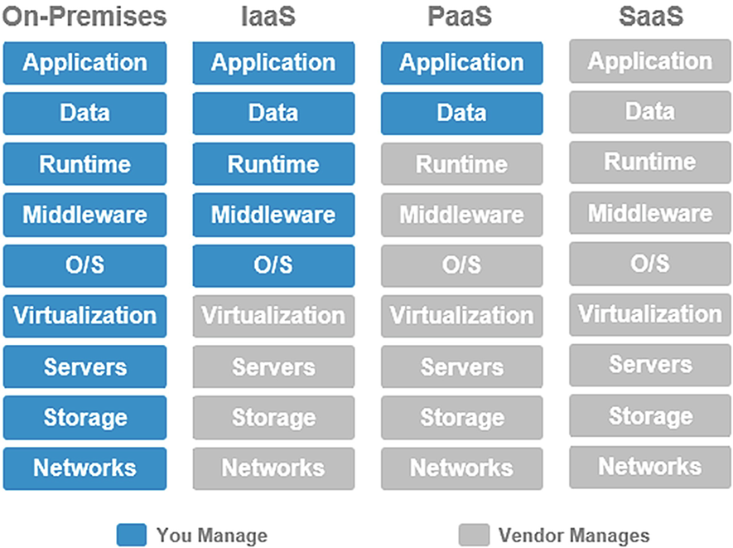
The maintainer of these resources?!
As an IoT service client, you may own/maintain different shares of the supporting resources. This is a way of service classification.
IaaS: Infrastructure as a Service; PaaS: Platform as a Service; SaaS: Software as a Service
Notes:
Runtime refers to the management of computing resources whenever they are needed/occupied. You may pay for runtime in a 24/7 (fully reserved functionality and corresponding resources) or just pay for whenever needed/occupied.

Slide 4
In-class tasks
Check Q1 of ‘hDay 5 in-class task’ on moodle

Slide 5
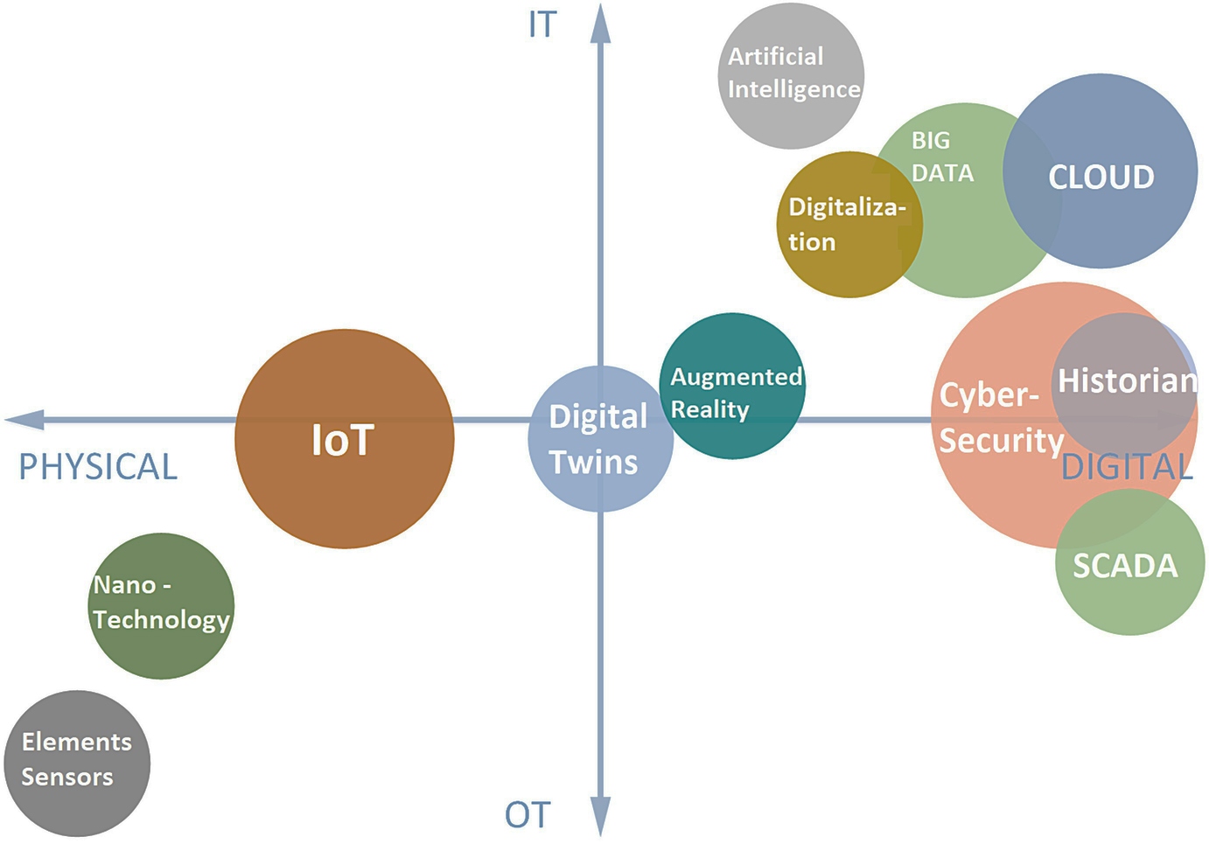
IoT in a bigger picture
IoT is not actually an entirely cyber oriented system
IoT is more of a physical domain system
OT: Operation Technology
Focus on physical device/machine
IT: Information Technology
Focus on data and soft elements
Digital/cyber dominant use cases
Industrial Use Case
Operational/physical dominant use cases
Source: ISA 95

Slide 6
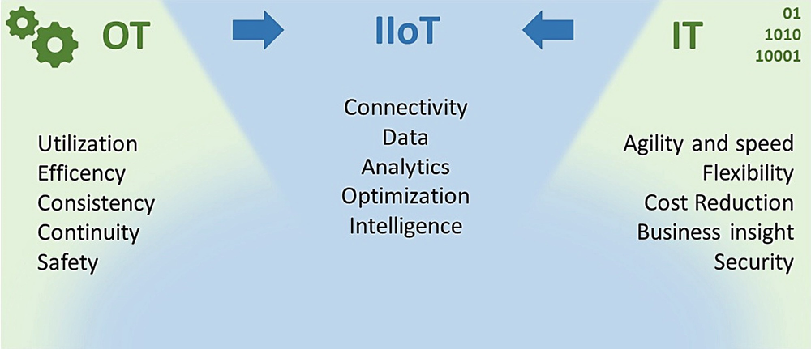
IT + OT → Industrial IoT
Although the mixture levels of IT/OT components in an IoT solution is not always based on a pre-planned scenario, they are the determining factor of the final IIoT solution character → different flavour/narration of IIoT e.g. the story of Industry 4.0
One important viewpoint: IIoT optimisation ← IT cost reduction + OT efficiency

Slide 7
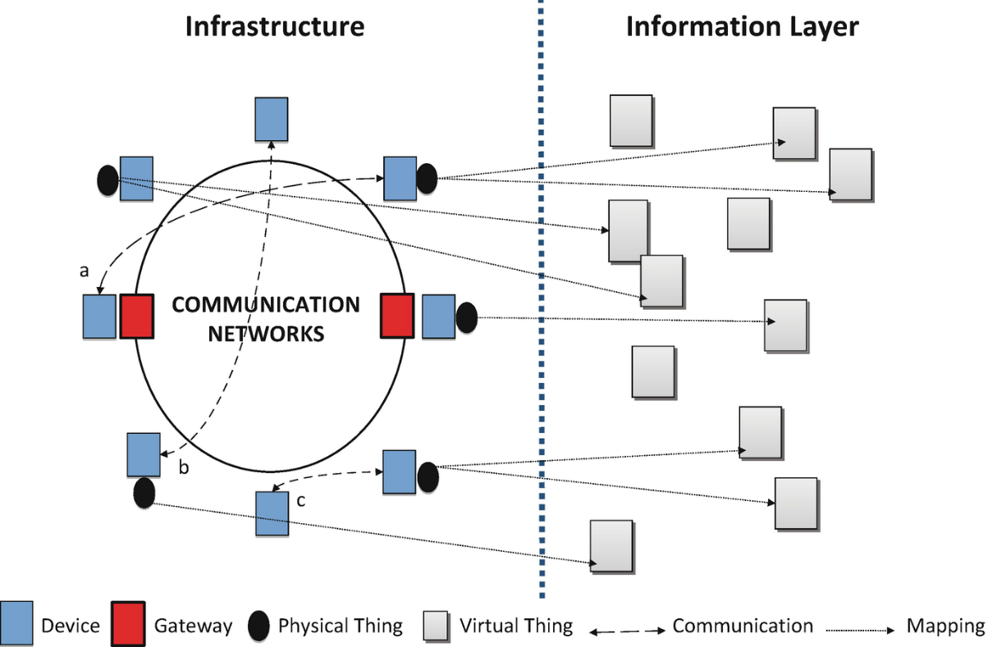
Physical- Cyber duality and twins
IoT Physical infrastructure and its Cyber counterpart may complement each other in different ways. You may think of examples in which a certain information represent one or more physical components and those components interact through various mediums: below ‘a’ represent interact through a gateway, ‘b’ represent a direct communication (e.g. internet) and ‘c’ represent a peer-peer connection.

Slide 8
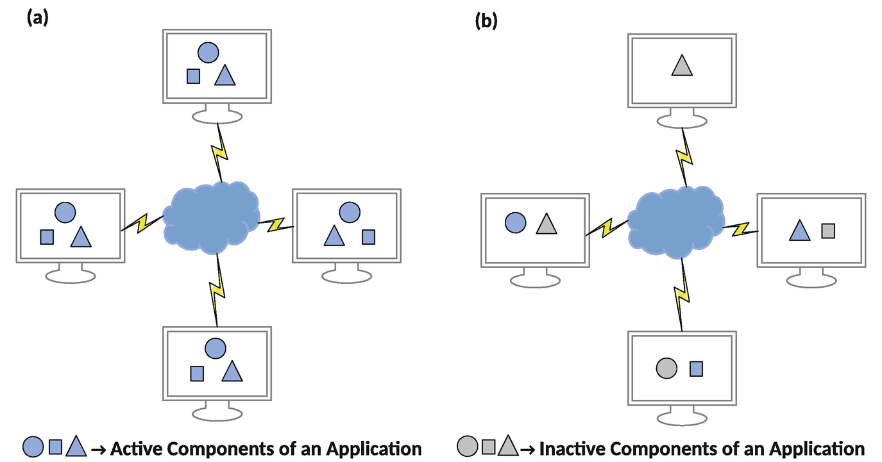
Resource allocation scenarios
If an application is served from network then its components might be distributed and/or decentralised
Say, an IoT app = authentication + dashboard visualisation + payment control + …

Slide 9
In-class tasks
Check Q2 of ‘ hDay5 in-class task’ on moodle

Slide 10
Typical Requirements in an IIoT
Diversity of quality benchmarks and requirements in an IIoT model might be much wider than a locally managed smart home use case.
Service criticality benchmark defined based on Latency and Reliability is a very common approach in contemporary IoT use cases

Slide 11
Satisfactory Technologies
Different parts of an IoT ecosystem have their own impact on service quality. For example:
The impact of local processing capability
The embedded system capability, the type of interfaces
Messaging protocol
MQTT over TCP/IP vs CoAP over UDP
Authentication/security approach
Local authentication vs server-based identification
Wireless Communication
IEEE802.11 vs IEEE802.15.1 vs IEEE802.15.4
….

Slide 12
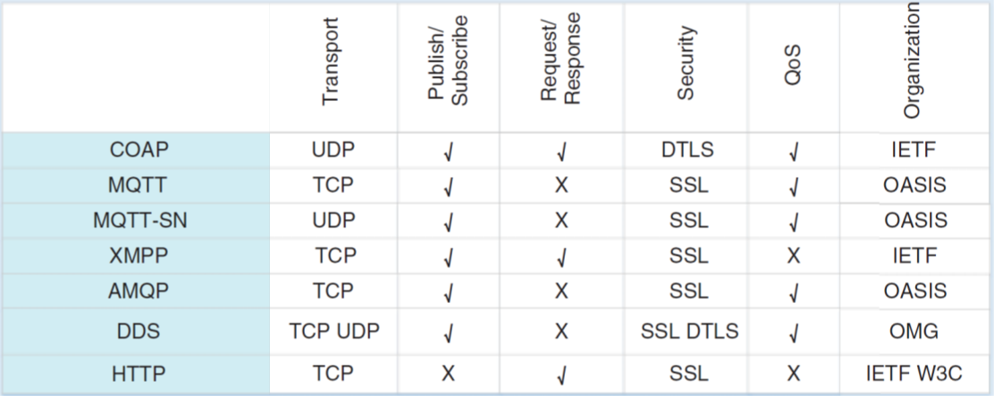
Satisfactory Technologies for IIoT messaging/transport/security protocol packages
IIoT may require more diversity for messaging protocol package, e.g. based:
QoS (latency, reliability …)
Security
Networking logistics
…

Slide 13
Satisfactory Technologies for IIoT: Wireless Communication
Timeline of some of the industrial wireless communication technologies
Notes:
Reference: Industrial IoT, Challenges, Design Principles, Applications, and Security.
https://0-link-springer-com.pugwash.lib.warwick.ac.uk/book/10.1007/978-3-030-42500-5
Wi-Fi: Wi-Fi technology is based on IEEE 802.11.x standards. Up to now, there are 6 main Wi-Fi generations, e.g. (i) 1st generation: 802.11b, (i) 2nd generation: 802.11a, (i) 3rd generation: 802.11g, (i) 4th generation: 802.11n, (i) 5th generation: 802.11ac, (i) 6th generation: 802.11ax. Every new generation has high interoperability with the previous generations. In general, Wi-Fi uses mid-range spread spectrum with orthogonal frequency division multiplexing technology and offers high data-rate connection with relatively higher power consumption and higher cost on transceiver modules, compared to IEEE 802.15 based solutions. Of course, more power consumption degrades the life-time of battery-powered transmitters which is not desirable for most of the industrial applications. In order to deal with these problems, new IEEE solutions such as White-Fi and Hallow are developed.
Bluetooth: The main goal of this IEEE 802.15.1 based technology is to provide low-cost and energy-efficient transceiver modules to the market. Today, millions of Bluetooth devices are being used and it is expected that more than 5 billion Bluetooth devices will be sold by 2022. Bluetooth uses universal short-range radio link with frequency hopping spread spectrum technology which makes it highly immune to interference and increases the security. However, up to now, the main focus of Bluetooth technology was human-machine interfaces but not industrial applications. Recently, numerous number of researchers are proposing improvements and new features on the current Bluetooth protocol in order to make it compliant to the stringent requirements in industrial applications.
ZigBee: ZigBee is based on the IEEE 802.15.4 standard and proposed by ZigBee Alliance, which is a non-profit open-source community group. Today, with more than 70 million ZigBee devices operating worldwide, it is one of the most widely used wireless communication solutions. ZigBee mainly focuses on low-power, low-cost, and low data-rate transmission scenarios which suit in most of the industrial applications. However, ZigBee uses carrier sense multiple access schemes which is not suitable for mission-critical industrial applications since it does not offer a consistent solution for high reliability and low end-to-end latency constraints.
WirelessHART: This protocol is based on the IEEE 802.15.4 standard and is the wireless version of the wired Highway Addressable Remote Transducer (HART) protocol. WirelessHART was originally developed by HART Communication Foundations in 2007. Today there are more than 40 million industrial devices worldwide that are using WirelessHART, specifically for industrial measurements and control applications. WirelessHART offers high reliability, up to 10⁻⁵ error rate, and high security by implementing time synched time division multiple accessing technology. However, no stringent constraint on end-to-end latency is introduced. On the other hand, since WirelessHART does not support the Internet protocol (IP), a significant interoperability problem with the next-generation communication systems for IIoT applications may arise.
ISA100.11a: Similar to WirelessHART, ISA100.11a is also based on the IEEE 802.15.4 standard and uses time synched time division multiple accessing in the physical layer to increase reliability and security. ISA100.11a is designated to provide reliable and secure transmission for non-critical monitoring, alerting, open and closed-loop control applications with end-to-end latency values in the order of 100 ms. WirelessHART and ISA100.11a are very suitable for several industrial applications which does not require ultra low-latency. However, interoperability issues with the current IP protocols stands as a serious problem that need to be tackled. Nevertheless, to ensure seamless connection between IP and ISA100.11a, novel approaches are proposed in.
6LoWPAN: Similar to the technologies listed above, 6LoWPAN is also based on the IEEE 802.15.4 standard. The main advantage of this protocol is that it enables the use of current and next-generation IP protocols, simultaneously. By communicating over IP networks, 6LoWPAN allows the communication system to directly connect to the other networks simply by connecting to an IP router, which significantly decreases the implementation cost and makes it prominent for various IIoT applications. 6LoWPAN is capable of meeting specific latency requirements as low as few miliseconds. However, this can only be supported in unreliable mode.
LoRa: Based on the media access protocol LoRaWAN, LoRa is a physical layer protocol for low-power wide area networks. LoRa is a convenient and promising technology for low-cost, low-power and long-range wireless networks. Similar to Bluetooth, LoRa also uses frequency hopping spread spectrum technology. On the other hand, LoRa uses unlicensed sub-1GHz bands to enable better coverage in the order of several kms in urban environments with data-rates up to 50 kbps.
SigFox: Similar to LoRa, SigFox is also a low-power wide area network solution for low-power, low-cost and long-range requirements. It is based on a patented ultra-narrowband technology and uses sub-1 GHz bands. SiGFox enables the connection of massive number of devices with ranges up to 20 km in rural areas. A fixed packet size, e.g. 12 bytes, is transmitted successively three times in order to increase reliability. However, end-to-end latency values on the order of seconds are allowed. SigFox and LoRa are suitable for most of the monitoring applications, such as water-meter reading, but not for mission-critical applications due to the high end-to-end latency values.

Slide 14
In-class tasks
Check Q3 of ‘hDay5 in-class task’ on moodle

Slide 15
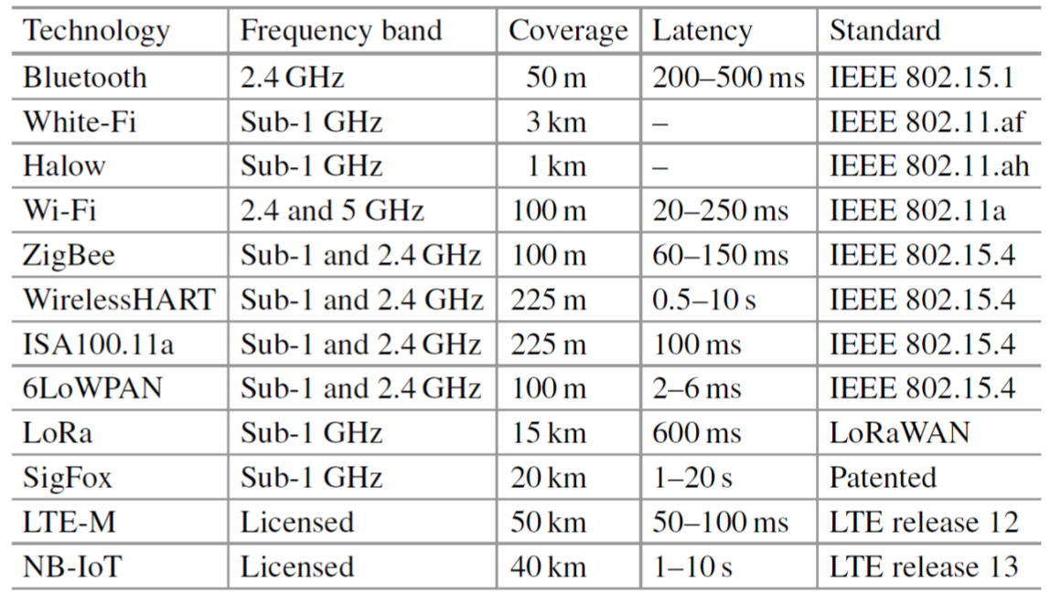
Recall: communication characteristics
Some important characteristics to be taken into account:
Frequency band, rate, coverage, latency …

Slide 16
IIoT applications with higher expectations
IIoT may have a high level of quality expectations is some use cases. Below are some typical use case requirements of URLLC (Ultra-reliable low-latency communication) applications: → this is where 5G technologies claims a play role
Note that this can be compared to a normal latency in the order of ‘seconds’ and reliability in the order of 10e-2 or 10e-3 acceptable error ratio.
More detail: industrial IoT (library resource)
Notes:
ITU’s Tactile Internet represents a secure network with low latency/high availability and reliable connection.

Slide 17
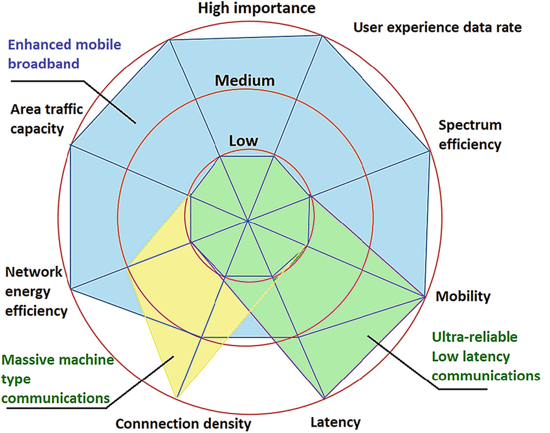
IT is about trade-off!
Note that a satisfactory services such as URLLC can be achieved through a trade-off based on other aspects of the service such as spectrum efficiency, energy efficiency etc
Industry 4.0, twin tech, Distribution/decentralisation, 5G, … all are various ways of expressing the manifestation of these requirements

Slide 18
End of session

